Slide 1


HR Data Analysis Report
In-depth analysis of employee data to support HR decisions
Covers demographics, diversity, salaries, and retention trends
Follows Data Analysis Lifecycle from collection to recommendations
by Khola Shams

Slide 2
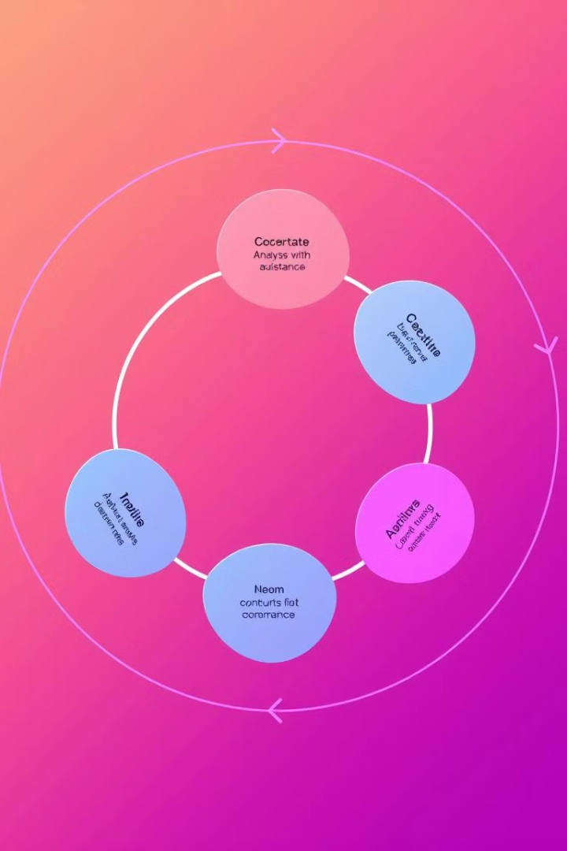
Data Analysis Lifecycle Overview
1
Business Understanding
Define objectives and goals for the analysis
2
Data Understanding
Explore data sources and identify key metrics
3
Data Preparation
Clean and prepare data for analysis
4
Data Analysis
Perform descriptive and diagnostic analysis

Slide 3

Business Understanding
1
Workforce Diversity
Analyze employee demographics and diversity patterns
2
Compensation Trends
Examine salary distribution across departments and roles
3
Employee Retention
Identify turnover trends and high-risk areas
4
Geographic Distribution
Map employee locations and regional differences

Slide 4
Data Understanding
Data Sources
Key Metrics
Employee ID
Diversity Metrics
Personal Information
Compensation Metrics
Job Details
Retention Metrics
Compensation
Geographic Data

Slide 5





Data Preparation (Cleaning)
Correcting Data Types
Ensure proper formatting for numeric and text fields
Handling Missing Data
Infer missing values or flag incomplete records
Removing Duplicates
Eliminate duplicate employee entries for accuracy
Standardizing Formats
Maintain consistency in geographic and categorical data

Slide 6

Data Analysis Overview
Descriptive Analysis
Identify general trends in demographics and distribution
Diagnostic Analysis
Examine reasons behind key trends and patterns
Gender and Leadership
Analyze gender distribution in senior roles
Ethnic Disparity
Investigate representation of minorities in leadership

Slide 7




Data Visualization Techniques
Gender and Ethnicity
Pie charts for gender distribution
Salary Distribution
Histograms for salary ranges
Hiring Trends
Line charts for hiring patterns
Geographic Distribution
Scatter maps for employee locations

Slide 8

Key Insights
Gender Balance
Fairly balanced, women in senior roles
Ethnic Diversity
Underrepresentation of Black employees in leadership
Salary Inequity
Geographic discrepancies, especially Manaus vs Seattle
Turnover Rates
Higher in Finance and Operations departments

Slide 9

Recommendations
1
Diversity Programs
Implement mentorship and diverse recruitment initiatives
2
Salary Equity
Conduct comprehensive audit to address geographic disparities
3
Retention Strategies
Develop targeted programs for high-turnover departments
4
Global Expansion
Diversify talent pool in underrepresented regions

Slide 10

Conclusion
Comprehensive Analysis
Insights into workforce demographics, salaries, and retention
Actionable Recommendations
Targeted strategies to improve diversity and performance
Future Impact
Potential for more equitable and high-performing organization

